Slide 1
Integrating Container Security and Compliance

Slide 2

Upload Container to Registry
Overview
Script blocks
Advanced docker pipeline steps
Setup 3rd Party Scanning Tools
Anchore
Trivy
Run Both Scans in Parallel

Slide 3



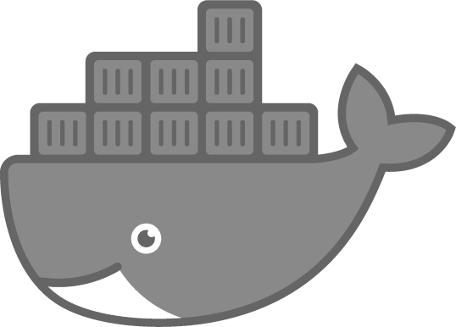

Course Pipeline

Slide 4
Demo
Upload Container to Registry

Slide 5

Trivy
Open Source
Maintained by Aqua Security Container Vulnerability Scanner https://github.com/aquasecurity/trivy

Slide 6
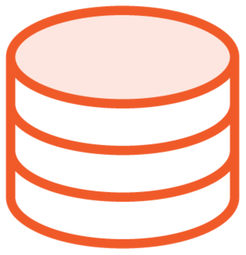


Run Trivy
Trivy Binary
Vulnerability Database
Scan Container

Slide 7

Run Trivy
Run Trivy
trivy <Container to Scan>

Slide 8
Run Trivy Stage (Windows)
Run Trivy
stage('Run Trivy') {
steps { pwsh(script: """
C:\\Windows\\System32\\wsl.exe --
sudo trivy blackdentech/jenkins-course
“””)
}
}

Slide 9
Run Trivy Stage (Linux)
Run Trivy
stage('Run Trivy') {
steps { sh(script: """
trivy blackdentech/jenkins-course “””)
}
}

Slide 10
Demo
Run Trivy Against Container

Slide 11

Anchore
Open Source with Enterprise Features
Maintained by Anchore Vulnerability & Policy Scanner
https://github.com/anchore/anchore- engine

Slide 12


Run Anchore
Anchore Engine
Anchore CLI
Scan Container
Anchore Database

Slide 13
Run Anchore (Windows)
Run Anchore
Write-Output "blackdentech/jenkins-course" > anchore_images
anchore name: 'anchore_images'

Slide 14
Run Anchore (Linux)
Run Anchore
echo "blackdentech/jenkins-course" > anchore_images
anchore name: 'anchore_images'

Slide 15
Run Anchore Stage
Run Anchore
stage('Run Anchore') {
steps {
anchore name: 'anchore_images’
}
}

Slide 16
Demo
Install and Configure the Anchore Plugin
Run Anchore Against Container

Slide 17



Sequential Stages
5 Minutes
5 Minutes
5 Minutes
15 Minutes

Slide 18
Parallel Stages
5 Minutes
5 Minutes
5 Minutes
10 Minutes

Slide 19

Parallel Stages
Push
Build
Trivy

Slide 20

Parallel Stages
Anchore
Push
Trivy

Slide 21
Demo
Run Anchore and Trivy Stages in Parallel

Slide 22
Upload Containers to Registry
Anchore
Summary
Setup Plugin
Run Scan
Trivy
Run scan from pipeline
Running Stages Parallel

